Slide 1
Design of Software Systems CS 509
Fall 2022
Provisional Use Cases Start : TO REVIEW TUESDAY SEP-20th
Prof. George Heineman
WPI
heineman@cs.wpi.edu

Slide 2
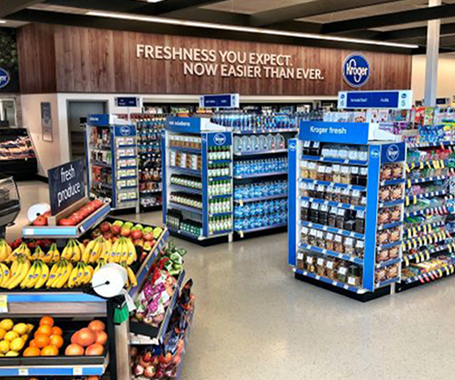
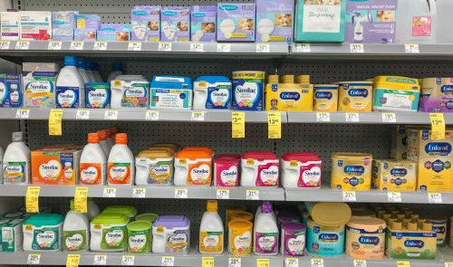
Context
Managing inventory in a single store is challenging …
Especially when managing multiple stores …
And dealing with overstocked items …
While providing exceptional online customer service …
Shelf 1
Shelf 5
Aisle 1
Shelf 2
Shelf 6
Aisle 2
Shelf 3
Shelf 7
Aisle 3
Shelf 4
Shelf 8
Each store has identical Aisle layout (1, 2, 3, …)
Each Aisle has shelves that are identical (1, 2, 3, …)

Slide 3
Course Project
Context
A startup company wants to disrupt Inventory Management Systems
Goal is to open brick & mortar stores that are identical when customers browse shelves in person
Allow customers to buy items (and walk in and collect them)
Overstocked storage contains extra inventory that cannot fit on shelves
Goal
Corporate:
Can uniformly design store layout to maximize item visibility
Manager:
Can receive shipments and stock shelves (with extra items stored separately in overstock). Note: act as if items actually arrived at store
Customers:
Can locate items (and identify those aisles/shelves containing these items) even including overstocked items in any store

Slide 4
Primary Requirements
Corporate defines inventory items (authenticated)
Each item has a SKU (Stock Keeping Unit) and a name and a description and a price
Items can be created but cannot be deleted
Every item is assigned to a designated Aisle and Shelf in a store
An item declares the maximum # of times it can be placed on a shelf
Can produce report of total inventory (and valuation) in a store
Can create a new store and remove an existing one. Each store has a GPS location
Store Manager (authenticated)
Process shipment from corporate containing various items (and quantities) which are either placed on the shelves (if there is room in that store) or placed in overstocked area
Can request to “fill-to-max” on the shelves for any/all items in overstocked in their store
Can compute total inventory valuation at their store

Slide 5
Primary Requirements
Customer (anonymous)
Can generate list of available stores (with their GPS location) in order of closest distance to customer’s given GPS
Can produce list of items (and quantities) on any shelf in any store
Can search whether item is available (by SKU or name or description) at any store
From this generated list, customer can BUY* a given allowable quantity of an item from a specific store
BUY* DO NOT create or maintain a shopping cart. You can assume that the product is immediately removed from the shelf and customers will simply pick the item up on their own time. These actions are outside the control of your system.

Slide 6
Corporate Use Cases
Create Item
Assign Item Location
Create Store
Remove Store
Generate Total Inventory Report
Generate Inventory Report
Each Item has a SKU, name, description and price.
Once an item is created, none of this information will change. [KEEP SIMPLE]
Once an item has been assigned, it won’t be reassigned [KEEP SIMPLE]
Total Inventory report is for all stores.
Inventory Report is for a designated store

Slide 7
Manager Use Cases
Process Shipment
Generate Inventory Report
Generate Overstock Report
Fill Shelves
Show Missing Items
A shipment from corporate contains any number of items and quantities. This shipment is processed in a given store and
Inventory report is for the manager’s store
Overstock report shows info on items in the manager’s store in overstock area.
The Fill Shelves use case will “fill to max” for any/all items in overstocked in the store.
Show Missing Items produces a report of items that have sold out in the given store

Slide 8
Customer Use Cases
List Stores
Items on Shelf In Store
Find Item In Store
Buy Item
List Stores shows the available stores (with GPS location) in sorted order of shortest distance to customer’s given GPS
Items on Shelf In Store can show the list of items on a given shelf for a given store (with quantities)
Find Item in store can search for a given item (by SKU or Name or Description) that is AVAILABLE in any store, as sorted in shortest distance to customer’s GPS.
Buy Item (from within the Find Item in store result) allows user to buy an allowable quantity of item from that specific store
BUY* DOES NOT create or maintain a shopping cart. You can assume that the product is immediately removed from the shelf and customers will simply pick the item up on their own time. These actions are outside the control of your system and are applied IMMEDIATELY.

